Slide 1
AWS CloudTrail

Slide 2
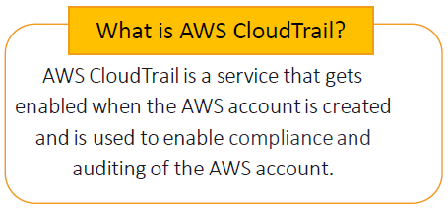


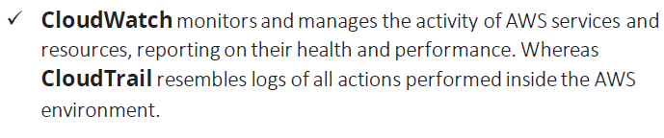

Slide 3
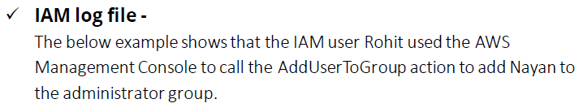
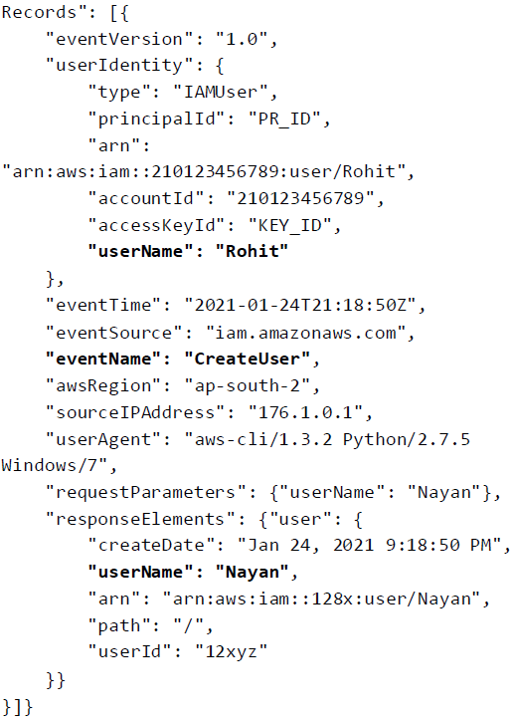

Slide 4
What does cloudtrail do for your AWS account?
AWS CloudTrail gives you a history of AWS calls for your account, including API calls made through the AWS Management Console, AWS SDKs, and command line tools.
As a result, you can identify: Which users and accounts called AWS APIs for services that support CloudTrail. The source IP address the calls were made from. When the calls occurred.

Slide 5
How does cloudtrail provide visibility into user activity?
CloudTrail provides visibility into user activity by recording actions taken on your account.
CloudTrail records important information about each action, including who made the request, the services used, the actions performed, parameters for the actions, and the response elements returned by the AWS service.

Slide 6
Can you create a trail across all regions in AWS?
You can create and manage a trail across all regions in the partition in one API call or few clicks.
You will receive a record of account activity made in your AWS account across all regions to one S3 bucket or CloudWatch logs log group.

Slide 7
How much does it cost to use cloudtrail?
Both trails are configured to capture management events; neither trail is configured to capture data events. You pay the S3 storage cost for all events.
You also pay CloudTrail charges for the second trail at the rate of $2.00 per 100,000 management events, because each additional copy of management events incurs charges.

